Slide 1
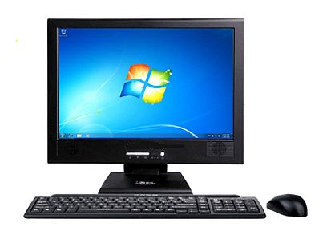

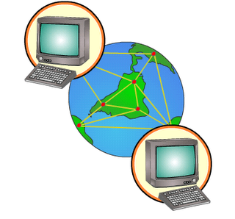
PwrMonitor: Block Diagram
GKE Dec 25th, 2019
RF 433MHz
RF 433MHz
USB
House
Electrical
Panel
2 x PZEM-16
NodeMCU
4x(RMS Converters & ADCs)
RS-485
RS-232
Processing
& WiFi
publishingv
Pri RS232
interface
USB
2 x RS485
interfaces
Sec RS232
interface
Analog
Measurements
(Voltage, Current, Phase Factor)
Phase #1 (V1, I1, ph1)
Phase #2 (V2, I2, ph2)
Thinger.io
IoT Service
IFTT
Service
ClickSend
Service
This Photo by Unknown Author is licensed under CC BY-SA

Slide 2
PwrMonitor.ino setup() and loop()
Allocates (used locally only):
CLI :: cli
EXE::exe
EEP::eep
BUF::buffer
TICsec::pr, streamTic
PROF::prof
GKE Dec 2nd, 2019
externIO.h declares:
cpu
cli
exe
eep
server
myThinger.cpp
Exports:
THING_STREAM()
THING_HANDLE()
notifyViaIFTTT()
sendtoDropbox()
myCliHandlers.cpp
Exports:
mypTable[ ]
CommonCLI.cpp (in Lw)
Exports:
cmnTable[ ]
inkParms2cmnTable()
L2 Library
OneWire.cpp
ds18Class.cpp
SimpleDHT22.cpp
mySupport.cpp
TICsec::secTic
reportVAP()
isSimulON()
isNotifyON()
setAnyMegParm()
setAnyEEParm()
getAllState()
showMegAllParms()
readSimulPhase()
getSimulPhase
refreshState()
SimpleSTA.cpp (in Lw)
L1 Library
cpuClass.cpp
bufClass.cpp
cliClass.cpp
eepClass.cpp
nmpClass.cpp
ticClass.cpp
mgnClass.cpp
myEngClasses.cpp
Defines & exports:
PZENG::eng
VWSTATS::shortT, longT
ALARM::alm
TMBASE::tmb
TOCsec::ticMin, ticHr
Allocates & exports:
CPU cpu
OLED oled
PZ16 pz( cpu, oled )
myGlobals.cpp
Defines & exports:
Global::myp
Allocates & exports:
NMP nmp
mgnClass.cpp
externIO.h

Slide 3
High Level Code Organization
setup()
Init OLED
Init Parms
Init CLI Tables
Wait for RETURN or BUTTON
Setup WiFi
Setup OTA
Setup Thinger
Setup EEPROM parameters
Loop() acquires measurements every 2-seconds
Minute and hourly statistics are computed
CLI and WEB interface access the above on request
History is saved on Dropbox periodically
WEB Interface
stdLoop()
Handle OTA
On cli ready,
Handle CLI
On secTic,
Read phases #1 & #2 alternating
Compute short term stats
Compute long term stats
Check for Alarms
CLI Handlers
Measurements
vap[1]
Vap[2]
Vap[1+2]
Statistics
Vmin
Vavg
Wavg
Wmax
kWh
If WiFi OK
Send to Dropbox periodically
Check for alarms
Send notifications
Handle Thinger
Else
Reconnect WiFi
Thinger

Slide 4
Wiring Diagram
PwrMonitor
GKE Nov 30th, 2019
D1-GPIO5-SCL
TXM
433MHz
GND
B
A
D2-GPIO4-SDA
OR-’32
3.3v
A2
A1
Va
OE
GND
GND
VCC
SCL
SDA
D6-GPIO12-SEN
TXS101
OLED
NodeMCU
D7-GPIO13-RxD
Vcc
GND
RxD
TxD
SET
Y
Vcc
D8-GPIO15-TxD
3.3v
RxD-GPIO13
3.3v
B2
B1
Vb
G
GND
TxD-GPIO15
3.3v
OR’ Gate
IF A=LOW, Y=TxD
IF A=HIGH, Y=HIGH
3.3v
SecondaryUART
To enable, set SEN (A) HIGH
GND
RxD
TxD
Vcc
RS485
GND
B-
A+

Slide 5
(1)
User speaks to Google Assistant
(2)
Google Assistant
Triggers IFTTT Applet APPL17.
(3)
IFTTT Applet APPL17 invokes Thinker.io device PZEM04, object pwrAssist.
(4)
Object pwrAssist dispatches to the appropriate method.

